Slide 1
Lecture 2
Round-Off Errors
Notes:
In this lecture we are going to learn about round-off errors.

Slide 2
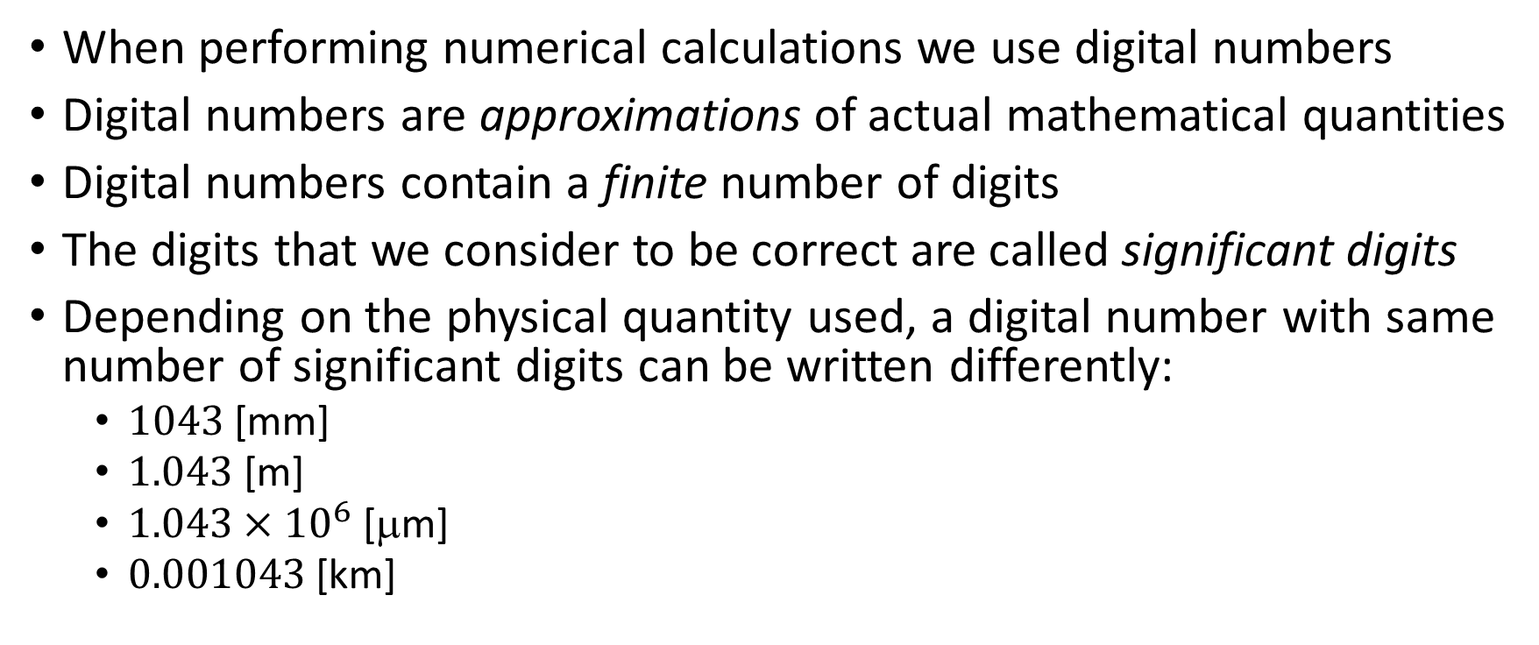
Digital numbers as approximations
When performing numerical calculations we use digital numbers
Digital numbers are approximations of actual mathematical quantities
Digital numbers contain a finite number of digits
The digits that we consider to be correct are called significant digits
Depending on the physical quantity used, a digital number with same number of significant digits can be written differently:
$1043$ [mm]
$1.043$ [m]
$1.043×{10}^{6}$ [μm]
$0.001043$ [km]
Leading zeros
Notes:
When performing numerical calculations we use digital numbers.
It is important to realize that digital numbers are approximations of actual mathematical quantities
The reason is that digital numbers contain a finite number of digits.
The digits that we consider to be correct are called significant digits. By correct we mean the same digits as the actual mathematical number.
For example 3.14 would have 3 significant digits if we use it as an approximation of the number pi.
Depending on the physical quantity used, a digital number with same number of significant digits can be written differently.
Consider for example a distance which measured in millimeters would be 1043.
The same distance expressed in meter would write$1.043$
Whereas in micrometers it would be $1.043×{10}^{6}$
Or in kilometers:$0.001043$ [km]
All these numbers have four significant digits.
Note in particular that leading zeros are not counted as you can see in our example where the distance is expressed in kilometres.

Slide 3
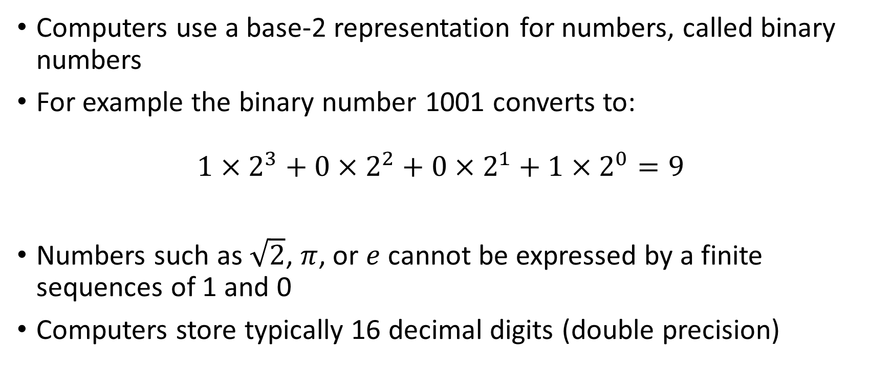
Handling numbers in a computer
Computers use a base-2 representation for numbers, called binary numbers
For example the binary number 1001 converts to: ${1×2}^{3}+{0×2}^{2}+{0×2}^{1}+{1×2}^{0}=9$
Numbers such as $\sqrt{2}$, $π$, or $e$ cannot be expressed by a finite sequences of 1 and 0
Computers store typically 16 decimal digits (double precision)
Notes:
A computer will use a base-2 representation for numbers. These numbers are called binary numbers.
For example the binary number 1001 is in fact the number 9 in decimal system as you can see if you convert it.
The number 9 can be represented exactly as 1001 in binary. Other numbers, such as for example $\sqrt{2}$, $π$, or $e$ cannot be represented exactly by a finite sequence of ones and zeros.
Computers will typically be able to represent up to 16 decimal digits correctly if you use the so-called double precision.

Slide 4
Round Off Errors
The difference between the mathematical number and the number stored in the computer is called round-off error
The origin of round-off errors is the fact that a computer can only store a finite number of digits
The consequence of round-off errors can be quite dramatic
Notes:
The difference between the mathematical number and the number stored in the computer is called round-off error
The origin of round-off errors is the fact that a computer can only store a finite number of digits
The consequences of the round-off errors can be quite dramatic.
Let us give some examples of such dramatic effects.

Slide 5
Illustration 1
Consider the following sequence of simple calculation in octave:
octave> a=2.6
a = 2.6000
octave> a=a+0.2
a = 2.8000
octave> a=a+0.2
a = 3.0000
octave> a=a+0.2
a = 3.2000
Now Let us compute a-3.2:
octave> a-3.2
4.4409e-16
The answer is wrong !
Notes:
In this first example let us start with the number 2.6 and add to it progressively the quantity 0.2.
In octave we can do this by first assigning the value 2.6 to a variable a.
Then we compute a=a+2 which will add 0.2 to 2.6
We repeat this two times more. To reach the answer of 3.2
So far nothing surprising. We simply confirmed that octave finds indeed 3.6 if one computes 2.6+0.2+0.2+0.2
Let us check this more carefully and compute a-3.2
We do not get zero.
So octave did in fact not find 3.2 as answer in the previous calculation, but something slightly different than 3.2
Why do we have this error?

Slide 6
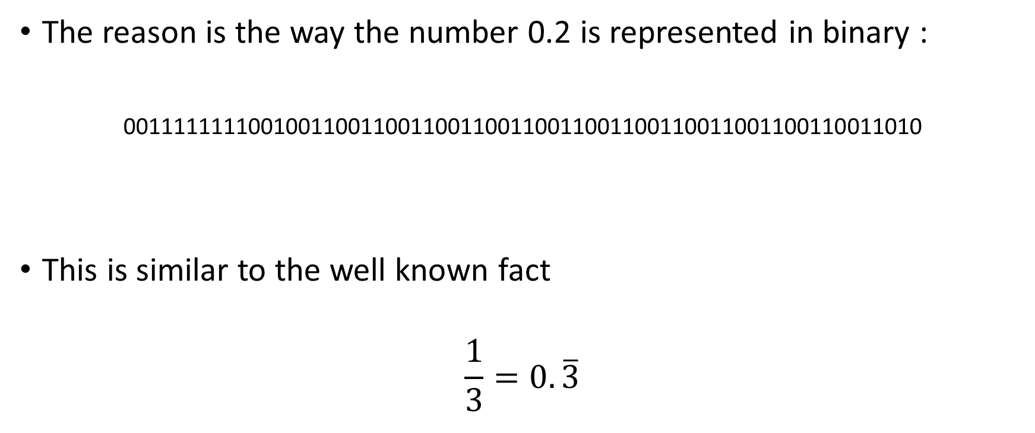
Why This Error ?
The reason is the way the number 0.2 is represented in binary :
0011111111001001100110011001100110011001100110011001100110011010
This is similar to the well known fact
$$\frac{1}{3}=0.\overline{3}$$
Round-off error
Notes:
The reason is that the decimal number 0.2 can not be represented exactly with a finite sequence of ones and zeros in binary system.
As octave uses a finite number of zeros and ones, it will have a small round-off error.
This is very similar to the case you know very well of 1 over 3 which in decimal approximation is 0.3 with an infinite number of threes.

Slide 7
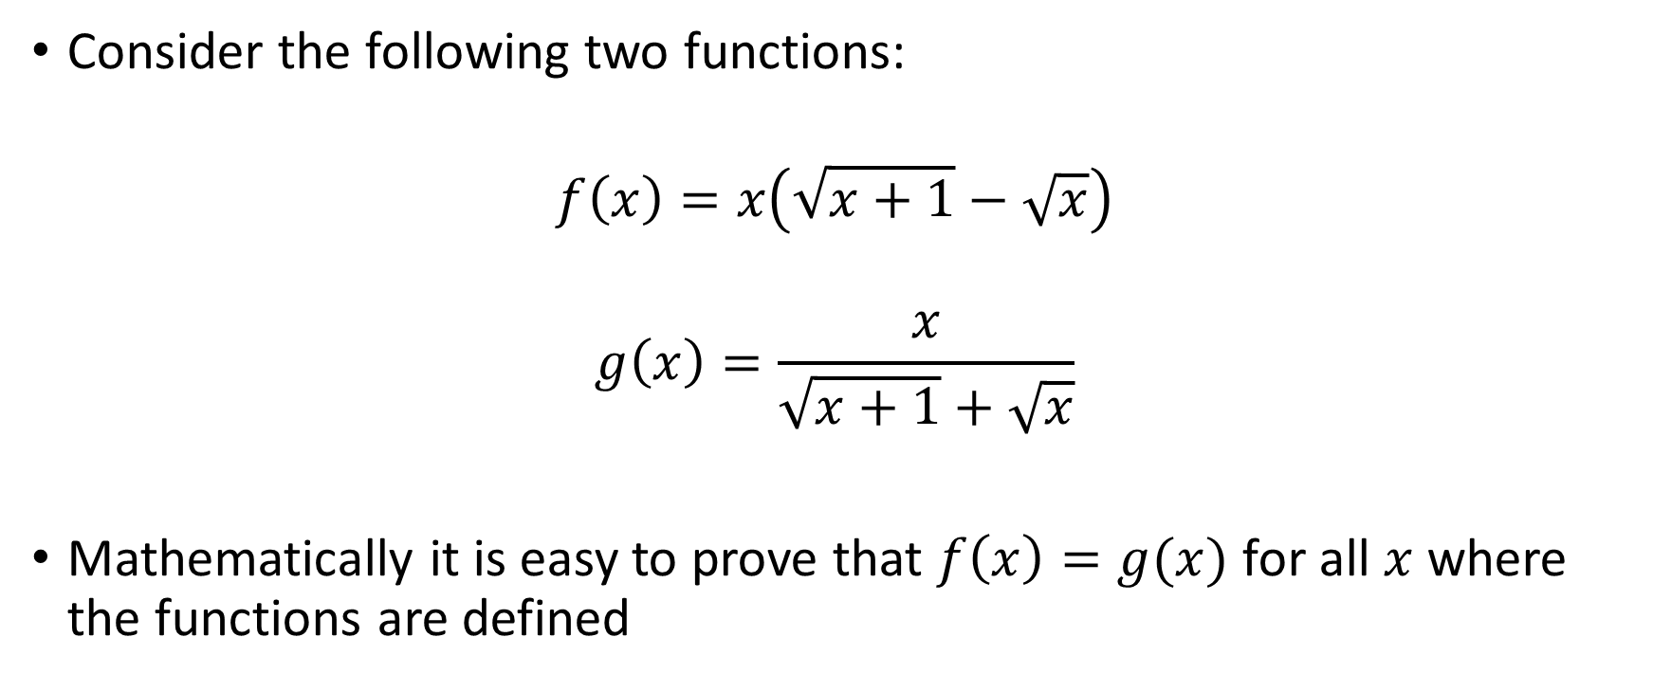
Illustration 2
Consider the following two functions:
$$f\left(x\right)=x\left(\sqrt{x+1}−\sqrt{x}\right)$$
$$g\left(x\right)=\frac{x}{\sqrt{x+1}+\sqrt{x}}$$
Mathematically it is easy to prove that $f\left(x\right)=g(x)$ for all $x$ where the functions are defined
Notes:
Round-off errors can enter in calculations differently depending on how operations are done.
Consider the two functions f and g displayed on the screen.
Mathematically f and g are in fact the same, only arranged a little differently.
I invite you to quickly prove this by yourselves.

Slide 8
Illustration 2
If the functions are equal mathematically, we get a different result when evaluating the functions numerically:
octave> f = @(x) x*(sqrt(x+1)-sqrt(x))
f =
@(x) x * (sqrt (x + 1) - sqrt (x))
octave> g = @(x) x/(sqrt(x+1)+sqrt(x))
g =
@(x) x / (sqrt (x + 1) + sqrt (x))
But
octave> f(500)-g(500)
ans = -3.4639e-13
Notes:
Let us now try to evaluate the functions f and g numerically to see if we always get the same answer or not.
For this let us define two functions f and g in octave.
Note the syntax used. In octave this type of syntax is called “inline function definition” and is very useful to quickly define a function.
Now that we have defined our two functions, let us evaluate them in some value of x.
For this let us compute f(500-g(500).
As you see octave does not find zero.
This means the two numerical results of f(500) and g(500), even if fairly close to each others, are not equal.
The reason of this difference are round-off errors.
We face a serious problem. Which one, if any, between f(500) or g(500) computes the right answer?
In fact, none of them calculates the right answer. Both are approximations. One of the question we will have to try to solve during the semester is to know how good are these approximations.

Slide 9

Illustration 3
Consider the following equation:
$$x^{2}{+9}^{12}x−3=0$$
The true mathematical solution is given by
$$x_{1,2}=\frac{−b±\sqrt{b^{2}−4ac}}{2a}$$
Notes:
As last example let us consider this quadratic equation.
You know very well what are the solutions of this equation and since long you know the formula to calculate them.

Slide 10
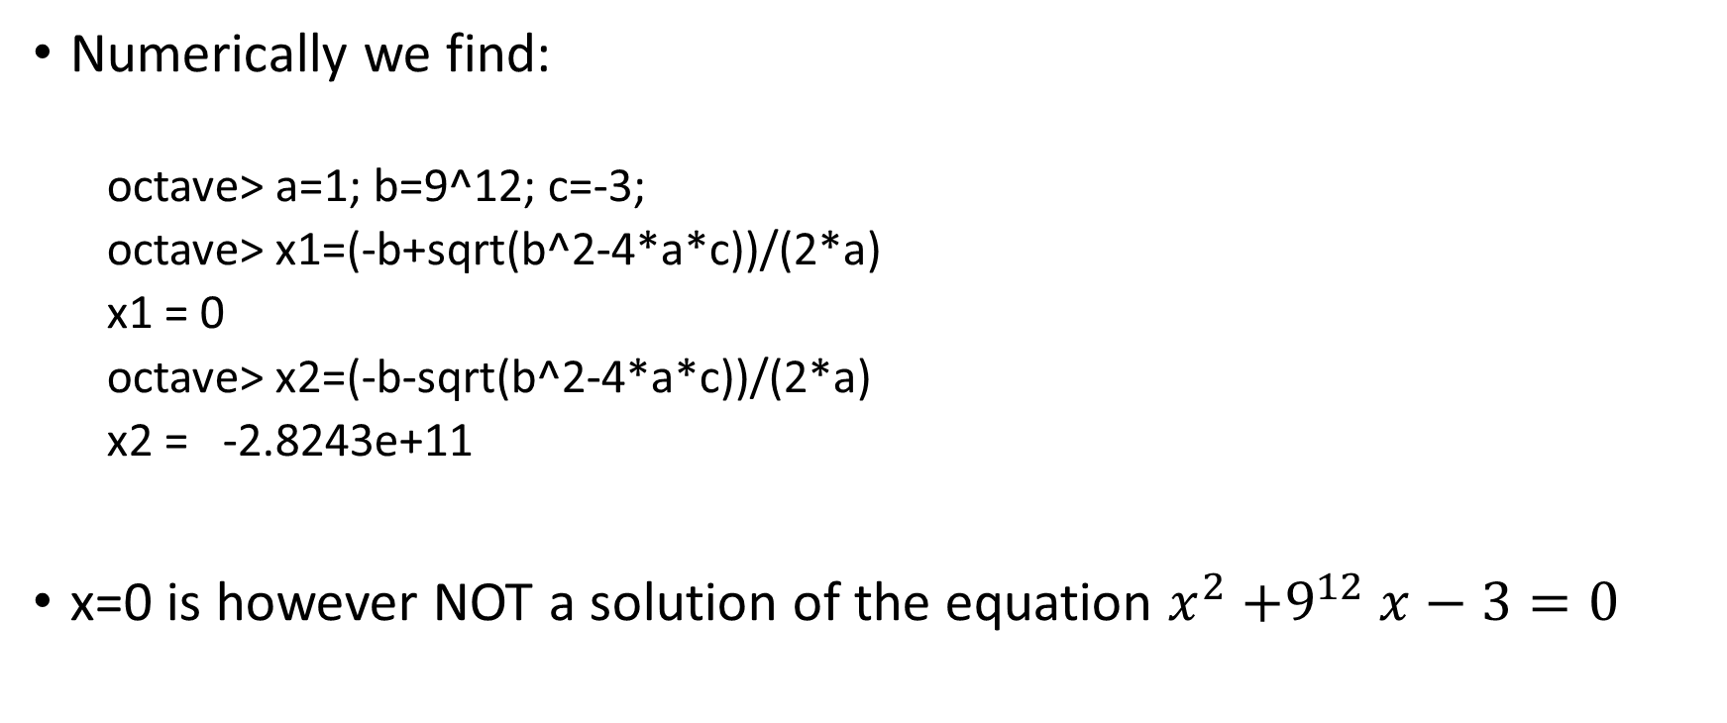
Illustration 3
Numerically we find:
octave> a=1; b=9^12; c=-3;
octave> x1=(-b+sqrt(b^2-4*a*c))/(2*a)
x1 = 0
octave> x2=(-b-sqrt(b^2-4*a*c))/(2*a)
x2 = -2.8243e+11
x=0 is however NOT a solution of the equation $x^{2}{+9}^{12}x−3=0$
Notes:
Let us apply our well known formula to calculate numerically the two solutions.
You can see that octave finds two answers. Among them one is x1=0
But x=0 is not a solution of the equation as you can easily very by plugging x=0 into the equation.

Slide 11
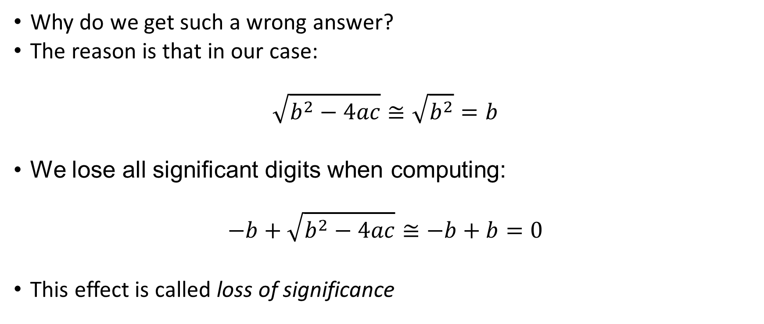
Illustration 3
Why do we get such a wrong answer?
The reason is that in our case:
$$\sqrt{b^{2}−4ac}≅\sqrt{b^{2}}=b$$
We lose all significant digits when computing:
$$−b+\sqrt{b^{2}−4ac}≅−b+b=0$$
This effect is called loss of significance
Notes:
Why do we find this wrong answer?
The reason come from the term $b^{2}−4ac$. Due to the large value of b, this term becomes numerically the same as $b^{2}$
Consequently the formula to find the roots of the quadratic equation evaluates to zero.
This effect is called loss of significance
This is a common effect in numerical calculations and one of the most dramatic consequences of round-off errors

Slide 12
Summary
Computers can store only a finite number of digits
The error introduced by this fact is called: round-off error
In every numerical calculation round-off errors are present
At dramatic consequence can be loss of significance

